Slide 1
Inductive Metaphysics and Its Abductive Methodology Gerhard Schurz (Heinrich Heine University Duesseldorf, Germany)
1. Introduction
According to the dominant tradition, metaphysics is considered as a conceptual a priori discipline (Leibniz, Kant,… K. Fine 2012, …).
There is an alternative a posteriori conception of metaphysics (with informal roots going back to Aristotle): Inductive Metaphysics (IM). The term “Inductive Metaphysics” was coined by philosophical developments in the late 19th and early 20th century (W. Wundt, O. Külpe, E. Becher,…).
General characterization:
Inductive Metaphysics (IM) aims at an a posteriori justification of metaphysical claims, based on ampliative inductive and in particular abductive inferences from empirically given data. IM is embedded in a methodology that closely resembles that of science.

Slide 2
Relation of IM to conceptual a priori metaphysics: A priori methods such as conceptual analysis and concept explication are still considered an indispensable part of metaphysics. What IM merely claims is that the justification of many important metaphysical beliefs cannot proceed in a purely a priori manner, but needs empirical premises and abductive inferences.
Relation of IM to naturalized metaphysics: Naturalized metaphysics (NM) derives its theses more directly from science (Kincaid 2013, 3) and partly rejects abduction as a metaphysical method (cf. Ladyman 2012). In contrast, IM applies the abductive methodology explicitly, to empirical sources of different kind, including (i) empirical facts established by science, (ii) facts about successful (vs. unsuccessful) scientific practice, and (iii) everyday experience.

Slide 3
2. Why abductions are central to IM
In IM the notion of induction is understood in the wide sense: meaning all kinds of non-deductive, uncertain and ampliative inferences.
The wide understanding of "induction" is important for IM because it includes abduction, or IBE (inference to the best explanation).
In contrast, the narrow or Humean sense of induction: Projection of observed regularities to unobserved/future cases.
With Humean induction, one cannot introduce new concepts into the conclusion; so one cannot transcend the range of what is observable.
But metaphysical concepts and principles speak about the Unobservable. In this respect they are similar to theoretical concepts and principles in science.
Notes:
Inductive inference is understood in the broad sense: -- this was common understanding in the 19th century and partially still today; e.g. Pollock 1986, 42; Earman 1992; Bird 1998.

Slide 4
Important insight of post-positivist philosophy of science: Theoretical concepts such as "force" cannot be semantically reduced to observable concepts (Carnap 1956, Hempel 1951, 115; Sneed 1972, French 2008; Schurz 2014, sec. 5.1).
Conclusion: Abductions are needed whenever one reasons from observed phenomena to theoretical concepts. -- because abductions are the only kind of inference that can introduce new concepts relevantly into the conclusion.

Slide 5
Theoretical concepts in science and metaphysics in comparison:
Theoretical concepts in science describe unobservable entities (e.g., electrons) or relations (e.g., forces) that explain the observed phenomena in a unified way.
Concepts of IM are similar to theoretical concepts in science, as they go beyond the observable to offer unified explanations of the observable.
What distinguishes metaphysical concepts from theoretical concepts in science is their more general and transdisciplinary nature (cf. Paul 2012).
For example, while the notion of force belongs to physics, the more general notion of cause belongs to metaphysics. While the notion of a conservation law belongs to physics, the notion of law of nature belongs to IM.
Therefore, not only theoretical science but also IM needs abductive inferences.

Slide 6
3. More on abduction
Thesis: Abduction in the writings of late Peirce (1903, 5.189 ff.) is roughly the same as Harman's (1965) notion of IBE (Niiniluoto 2018, Douven 2021). In what follows I use the notions of "abduction" and "IBE" synonymously.
Important: The abducted conclusion (hypotheses) is highly uncertain and has to be confirmed by further tests (Peirce 1903, 5.171).

Slide 7
The general pattern of abduction:
Surprising Fact
Background Knowledge
====================
Explanatory Hypothesis (best among considered/conceivable alternatives)
Two major families of abduction (Schurz 2008, Magnani 2009, Niiniluoto 2018):
Selective abductions:
Creative (theory-generating) abductions:
Search for explanations of particular empirical facts by known laws or theories.
E.g.: Explanation of footprint by someone walking here.
Frequently studied, well-known search strategies (Flach/Kakas 2000, Aliseda 2006, Magnani & Bertolotti 2017).
Search for explanations of (general) empirical facts (regularities, dispositions) by new theories (about unobservable causes). Create new theoretical concepts and laws.
E.g.: Explanation of planets‘ trajectories by gravitational force of the sun.
Rarely studied (Schurz 2008, 2016, Aliseda 2023), but needed for scientific theories and abductive metaphysics.
=> focus of the rest of the talk.

Slide 8
4. The major challenge: Speculative abductions
For every set of facts one can create (‚abductively infer‘) a perfect post-factum ‘explanation’, by stipulating sufficiently many theoretical (hidden) variables.
Examples: Post-facto explanations of arbitrary facts by God's wishes, or by intricate conspiracy theories.
Explanandum E: Last week the Dow Jones index went up. ============================================================== Abducted conjecture: God made this to support Trump.
Note: For every observed fact a new wish of God has to be postulated post-factum ('metaphysical duplication’).
Thesis: Speculative abductions are without scientific/epistemic value, because:
(1) they do not provide unification, in the sense that a set of elementary facts is reduced to a smaller set of elementary principles (Friedman 1974, Schurz and Lambert 1994, … )
(2) they are not potentially predictive − therefore they are not independently testable by use-novel evidence (Worrall 2006).

Slide 9
Another example: Post-facto explanations of empirical dispositions by special powers:
Explanandum E: Opium has the disposition to make people sleepy. ============================================================== Abducted conjecture: Opium has a special power (a 'virtus dormitiva') by which it makes people sleepy. (Molière's example)
No unification, no independent testability, because for every temporal regularity a special power is postulated.
Conclusion: Two demarcation criteria between speculative and scientific abductions:
(1) unification and (2) independent testability (potential predictiveness).
Scientific abductions possess these two virtues to a high degree. Most scientific abductions proceed as follows: They infer from a set of intercorrelated empirical dispositions/regularities a common underlying theoretical property − a common ‘cause’. (What is ‘a cause’? see later)
Note: “Dispositions” are understood here as lawlike temporal regularities T(rigger) → R(eaction) (contra ‘dispositional essentialism’)

Slide 10
5. Common cause abductions in science
Example: Abduction of chemical kind concepts: Solubility in water
Other examples: Abduction of "force" in classical physics from bodies’ trajectories.
Abduction of common ancestors from similar species in evolutionary biology.
Kinds of
Substances:
Correlated (permanent) dispositions:
(1) x is soluble in water T₁(x) → R₁(x)
(2) x is non-soluble in oil T₂(x) → R₂(x)
(3) x is soluble in water-similar solvents
(ammonia …) T₃(x) → R₃(x)
(4) x not soluble in oil-similar solvents
(benzene,…) T₄(x) → R₄(x)
(5) x has an increased melting point …
T₅(x) → R₅(x)
(6) x-solutions conduct electricity
T₆(x) → R₆(x)
…
17-18th century:
Common theo-
retical property
or 'nature':
Hydrophilic
Sugar
Salt
Natroncarb.
Coppersulf.
…
19th century:
theoretical model:
Electric dipole

Slide 11
The common cause abduction yields unification: Given m substances and n correlated dispositions, there is a reduction of m⋅n empirical laws to m+n theoretical laws.
Entails novel predictions by which it is independently testable: E.g., if a substance is soluble in water, this indicates that it is hydrophylic and will not be soluble in oil.
6. The major challenge for IM:
Do metaphysical abductions also possess these two virtues?
Some philosophers reject the transfer of abduction from natural sciences to metaphysics (Ladyman 2012, Saatsi 2017, Beebee 2018).
Other philosophers advocate this transfer (e.g., Armstrong 1983, Paul 2012, Williamson 2016, Niiniluoto 2018, Schurz 2016, 2021).
Do metaphysical abductions at least possess the virtue of unification? Usually yes.
Is this first virtue enough? This is controversial. I think: no.
Do metaphysical abductions possess the second virtue of independent testability?
Not always. But at least sometimes. In the remainder I give two positive examples.
Notes:
If you want a strong argument against the view that metaphysics is post-hoc rationalization or an elaborated form of wishful thinking, then you should say: No.

Slide 12
On the relation between unification and independent testability:
Independent testability entails unification: Assume a theoretical hypothesis H is obtained by fitting H's theoretical variables (e.g., "God’s wishes", "forces", …) post factum to a given evidence E. Then H's independent testability requires that H implies further evidence E* that was not used in fitting H; therefore H unifies E* and E.
In the other direction, the implication fails: Even if H unifies two or several facts E and E*, H could have been obtained by a simultaneous fitting towards E and E*.
However: the more H unifies, the greater H’s chances to entail use-novel facts (cf. the statistical method of cross-validation).
Notes:
If you want a strong argument against the view that metaphysics is post-hoc rationalization or an elaborated form of wishful thinking, then you should say: No.

Slide 13
6 . Example 1: Justifying Perceptual Realism by Common Cause Abduction
Thesis: Justification of perceptual realism works in the same way as abduction in science, although unconsciously (Moser 1989, Vogel 2005, Niiniluoto 2018 ...):
There are strict correlations between our visual 2D perceptions of given objects from different positions – internal perception dispositions of the form: "if I look from this viewpoint, I have this-and-this visual impression".
Moreover: these visual dispositions are intercorrelated with tactile perceptions.
The best explanation: Is their explanation by a 3D object in 3D space that causes our position-dependent 2D images by the laws of perspectival projection of light rays.
Is predictively extremely powerful (Clarke 2013). Achieves powerful unification.

Slide 14
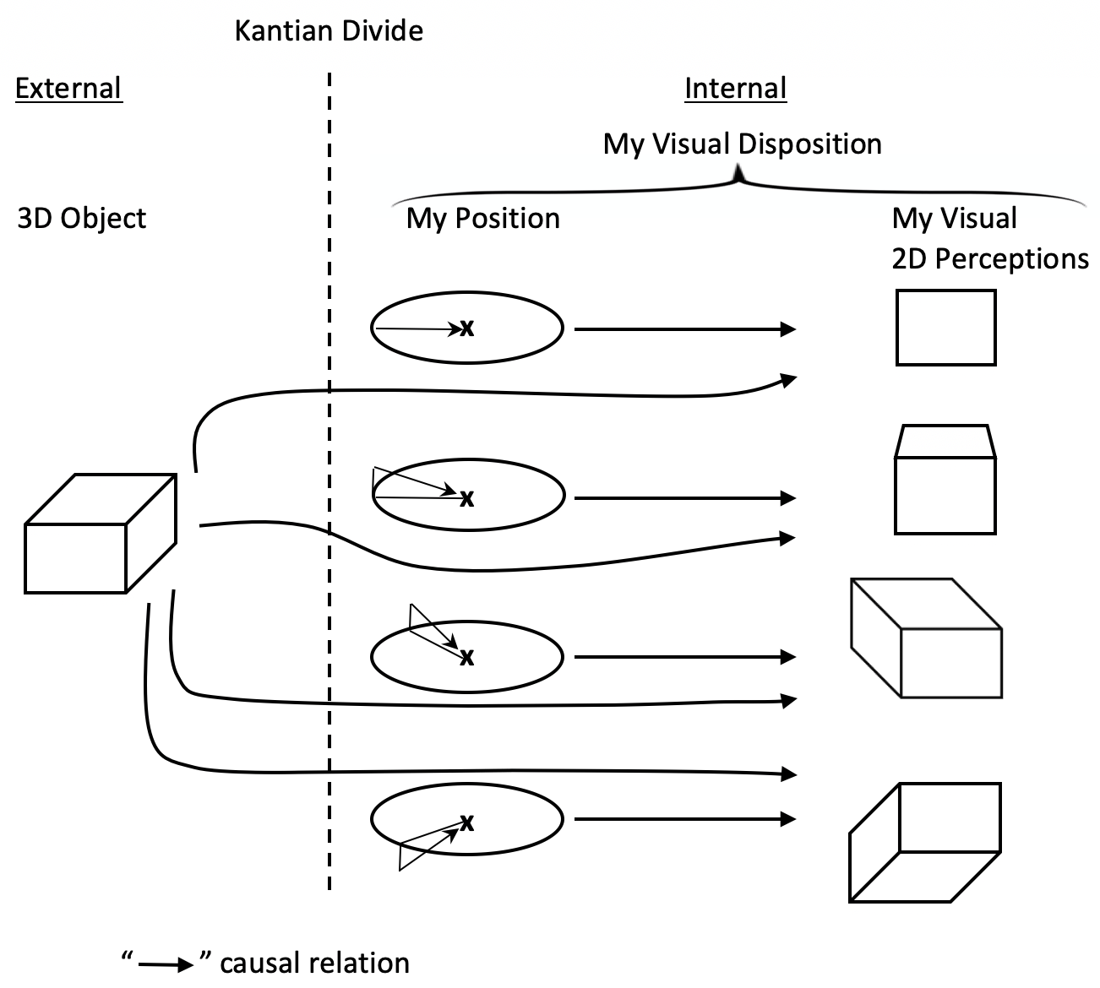

Slide 15
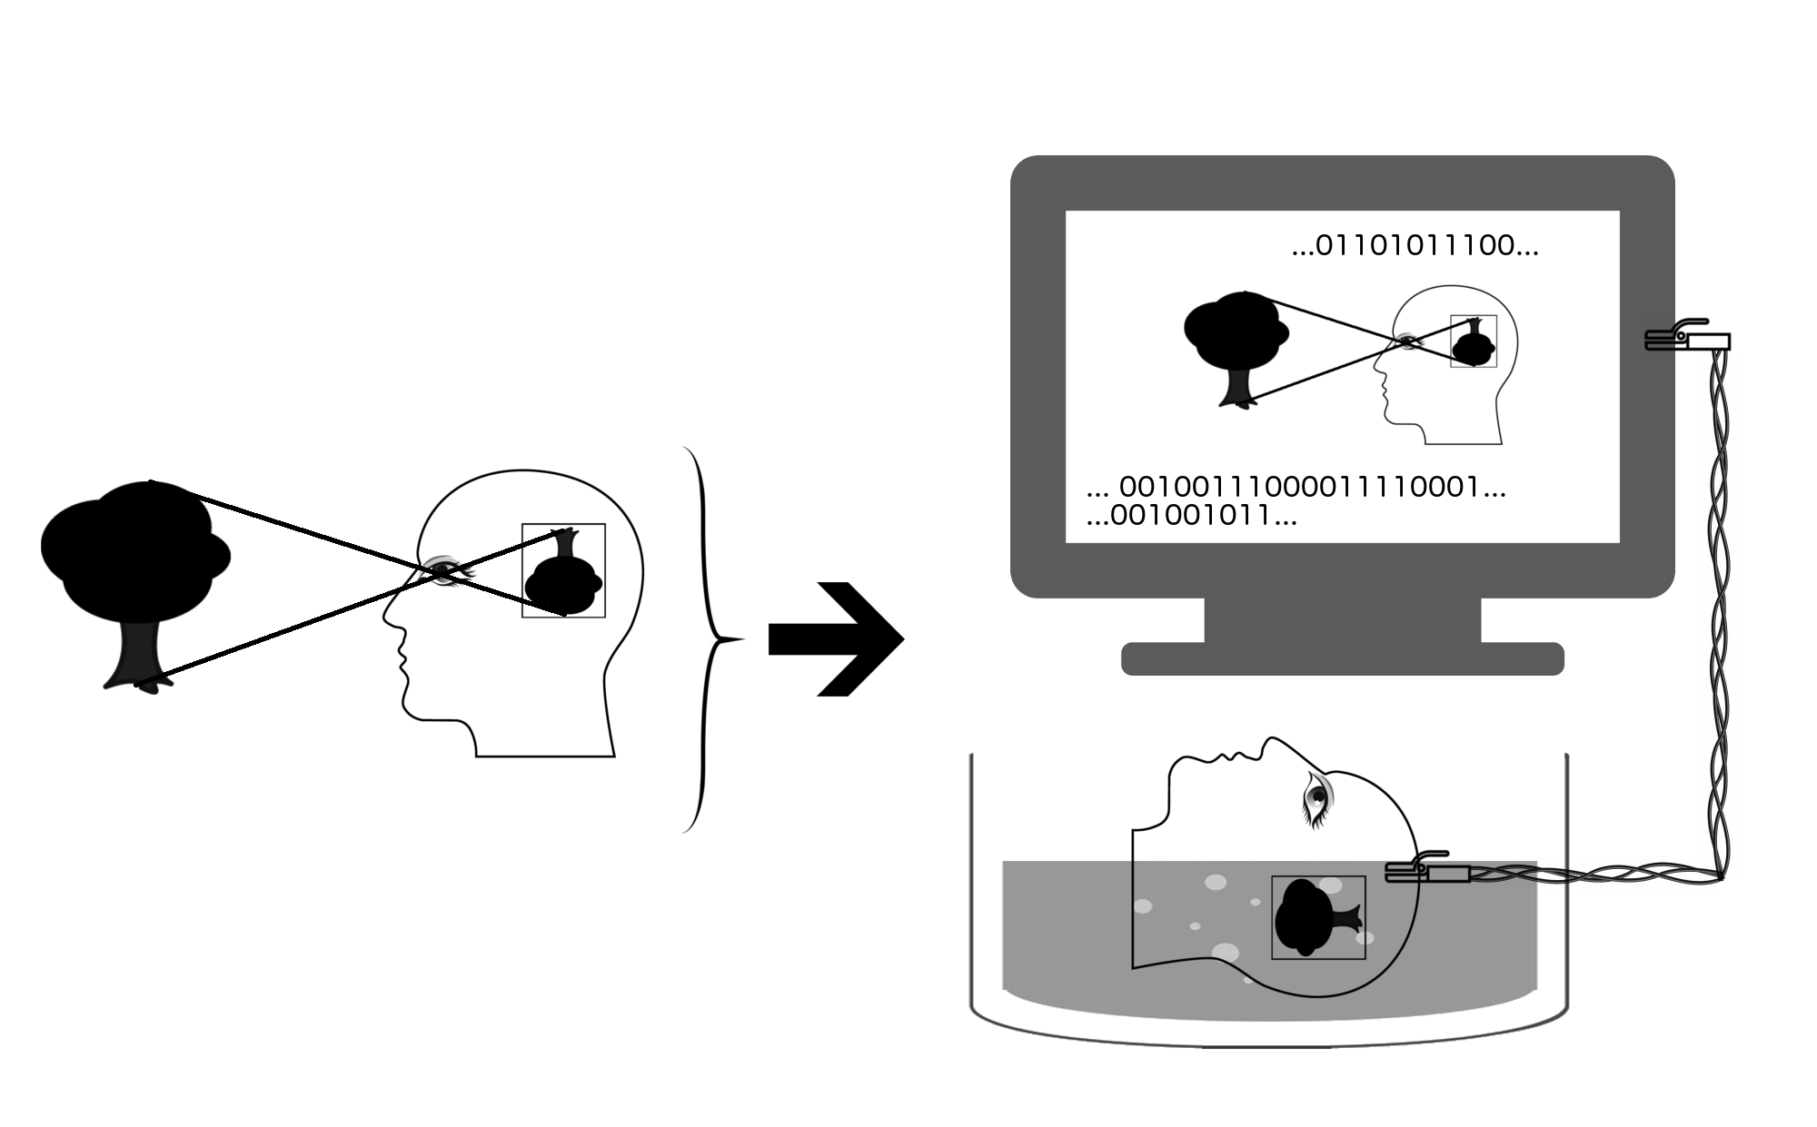
But is perceptual realism (PR) really the best explanation of our sense experience?
What about the alternative BIV (brain in the vat) explanation?
Proposed solution of the BIV problem:
The BIV explanation assumes an isomorphic copy of the ordinary realist explanation within the supercomputer and makes additional assumptions.
Therefore, the prior probability of BIV must be much smaller than that of PR.

Slide 16
7. Justifying Abduction by Causality
Possible criticism: The criteria of unificatory explanations and novel predictions are merely instrumentalistic.
What entitles us to assume that the abducted 'common cause' really exists?
Shouldn’t we better confine ourselves to the instrumentalistic position?
Proposal: Theory-generating abduction is justifiable by the following weak causality principle:
(C): If two properties or events are probabilistically dependent, then either one is a cause of the other, or both are effects of one or several common cause(s)
(implied by Markov condition, cf. Spirtes, Glymour, Scheines 2000; Pearl 2009).
Note: “Cause” is meant in the sense of a “causal factor” and the cause-effect relation may be probabilistic.
Argument: Correlated dispositions cannot be causes of other dispositions, because they have independently realizable trigger conditions. So they must be effects of an theoretical (unobservable) common cause.

Slide 17
Why dispositions with independently realizing trigger conditions cannot cause each other:
D₁ causes D₂? (e.g., solubility in
water causes non-solubility in oil)
NO! violates independence of A₁
R₁ R₂
A₁ A₂
Common cause abduction:
R₁ R₂
A₁ C A₂

Slide 18
Conclusion: The metaphysical principle of causality (C) gives us a deductive justification of theory-generating abductions.
Remaining problem: How can we justify the principle of causality?
8. Example 2: Justifying Causality by Non-Causal Abduction
We can have an abductive justification of causality. On pain of avoiding circularity, this justification must be non-causal, solely based on unification and predictive power.
According to Schurz and Gebharter (2016): Directed cause-effect relations offer best (available) explanations of two (in)stability properties of correlations:
1. Screening-off and 2. Linking-up

Slide 19
Explaining screening-off:
Here a probabilistic dependence between two variables X and Y is screened off by a third variable Z: DEP(X,Y) but INDEP(X,Y|Z)
Examples: 1. Barometer reading (X) storm coming (Y) atmospheric pressure (Z) 2. Male (X) car accident (Y) car speed (Z)
Best (available) explanation of screening-off: There exists a 'real' relation of 'direct' dependency between X and Z, and between Z and Y ("direct" relative to {X,Y,Z}),
But there exists no direct causal X-Y dependency: DEP(X,Y) is merely an indirect consequence of this - it is mediated by Z:

Slide 20
For explaining screening-off, undirected 'causal' dependencies are sufficient.
Directed causal dependencies are needed for explaining linking-up:
Here correlations have the opposite stability properties of screening off: INDEP(X,Y), but DEP(X,Y|Z).
Example: position of sun (X), length of tower (Y), length of shadow (Z)
Best (available) explanation of linking-up:
Again Z must mediate the probabilistic X-Y-dependency, but we have opposite probabilistic stability effects. → Causal dependencies are directed: Changes of value-distributions are propagated only along causal arrows.
It can be shown: two direction-combinations can explain screening off:
1. Intermediate cause Z: X→Z→Y
2. Common cause Z: X←Z→Y
Linking up is explained by the remaining third possibility:
3. Common effect Z: X→Z←Y

Slide 21
Schurz & Gebharter (2016) show: This abduction offers unified explanations and is potentially predictive.
In particular: If the causal Markov condition is enriched by additional assumptions such as (i) faithfulness or (ii) intervention possibilities or (iii) temporal forward-directedness, the theory of causality achieves empirical content.
10. Final question: What justifies theory-generating abduction independently from causality?
A justification is possible based on the epistemology of optimality justifications:
Details are worked out in my Book: Optimality Justification. New Foundations for Epistemology (OUP 2024). (extends my results on meta-induction - see Schurz MIT 2019 - to abduction )
The end - thank you

Slide 22
Appendix A3: Why the causal explanation of screening is the best one can give? Objections and replies:
Alternative explanation: Humean 'reduction' account or metaphysical duplication accounts: causal dependencies are 'duplications' of probabilistic dependencies.
Reply: Does not work. The explanation of screening-off is only possible because NOT every probabilistic dependency relies on a (direct) causal dependency.
X Y
Z
Further alternative explanations
... involve complications such as non-faithfulness.
For details see Schurz (2015).

Slide 23
References:
- Aliseda, A. (2006): Abductive Reasoning, Springer, Dordrecht.
- Aliseda, A. (2023): “On Schurz’s construction paradigm of scientific theory development”, Journal for the General Philosophy of Science 54, 473–490.
- Armstrong, D. M. (1983): What Is a Law of Nature? Cambridge Univ. Press, Cambridge.
- Beebee, H. (2018): "Philosophical Scepticism and the Aims of Philosophy", Proceedings of the Aristotelian Society 118(1), 1–24.
- Carnap, R. (1956): "The Methodological Character of Theoretical Concepts". In: H. Feigl and M. Scriven (eds.), The Foundations of Science, Minneapolis: University of Minnesota Press, 38–76.
- Clark, A. (2013): "Whatever Next? Predictive Brains", Behavioral and Brain Science 36, 181-253.
- Flach, P. and Kakas, A. (Eds.) (2000). Abduction and Induction., Kluwer, Dordrecht.
- Douven, I. (2021). “Abduction”, in: E. N. Zalta (Ed.), The Stanford Encyclopedia of Philosophy (Summer 2021 ed.).
- French, S. (2008): "The Structure of Theories", in: S. Psillos and M. Curd (Eds.): The Routledge Companion to Philosophy of Science, Routledge, New York, 269-280.
- Friedman, M. (1974): "Explanation and Scientific Understanding", Journal of Philosophy 71, 5-19.
- Harman, G. (1965): "The Inference to the Best Explanation", Philosophical Review 74, 88-95.

Slide 24
- Hempel, C. G. (1951): "The Concept of Cognitive Significance: A
Reconsidera­tion", reprinted in Hempel, C. G. (1965), Aspects of Scientific Explanation, Free Press, New York-London, ch. II.1.
- Kincaid, H. (2013): “Introduction: Pursuing a Naturalist Metaphysics”, in: D. Ross, J. Ladyman and H. Kincaid (eds.): Scientific Metaphysics, Oxford University Press, Oxford and New York.
- Ladyman, J. (2012): "Science, Metaphysics and Method“, Philosophical Studies 160, 1, 31-51.
- Magnani, L. and Bertolotti, T. (2017, eds.): Springer Handbook of Model-Based Science, Springer, Dordrecht.
- Moser, P. K. (1989): Knowledge and Evidence, Cambridge Univ. Press, Cambridge.
- Niiniluoto, I. (2018): Truth Seeking by Abduction, Springer, Basel.
- Paul, L. A. (2012): "Metaphysics as Modeling: The Handmaiden's Tale". Philosophical Studies 160, 1-29.
- Pearl, J. (2000, 2009). Causality, Cambridge University Press, Cambridge.
- Peirce, C. S. (1903): "Lectures on Pragmatism", in: Collected Papers of Charles S. Peirce (ed. by C. Hartshorne and P. Weiss), 5.14 – 5.212.
- Putnam, H. (1975a): "What is Mathematical Truth?", reprinted in: H. Putnam, Philosophical Papers. Vol. 1, Cambridge Univ. Press, Cambridge, 60-78.
- Saatsi, J. (2017): "Explanation and Explanationism in Science and Metaphysics", in: M. Slater and Z. Yudell (Eds.), Metaphysics and the Philosophy of Science: New Essays, Oxford University Press, Oxford 162-191.
- Schurz, G. (2008): "Patterns of Abduction", Synthese 164, 2008, 201-234.

Slide 25
- Schurz, G. (2014): Philosophy of Science: A Unified Approach, Routledge, New York.
- Schurz, G. (2015): "Causality and Unification“, Theoria 30/1, 73-95.
- Schurz, G. (2016): "Common Cause Abduction: The Formation of Theoretical Concepts and Models in Science", Logic Journal of the IGPL 24/4, 494-509.
- Schurz, G. (2021): "Abduction as a Method of Inductive Metaphysics", Grazer Philosophische Studien 98, 50–74.
- Schurz, G. (2024): Optimality Justifications. New Foundations for Epistemology. OUP, Oxford and New York.
- Schurz, G. and Gebharter, A. (2016) "Causality as a Theoretical Concept", Synthese 193 (4), 1071-1103.
- Schurz, G., and Lambert, K. (1994): "Outline of a Theory of Scientific Under- standing", Synthese 101/1, 65-120.
- Sneed, J. D. (1971): The Logical Structure of Mathematical Physics, Reidel, Dordrecht.
- Spirtes, P., Glymour, C., and Scheines, R. (1993, 2000). Causation, Prediction, and Search, The MIT Press, Cambridge/MA.
- Van Fraassen, B. (1989): Laws and Symmetry, Clarendon Press, Oxford.
- Vogel, J. (2005): "The Refutation of Skepticism", in: Steup, M., and Sosa, E. (Eds., 2005): Contemporary Debates in Epistemology, Blackwell, Oxford, 72-84.
- Williamson, T. (2016): "Abductive Philosophy", The Philosophical Forum 47(3-4), 263-280.
- Worrall, J. (2006): "Theory-Confirmation and History", in: C. Cheyne and J. Worrall (eds.), Rationality and Reality, Springer, New York, 31-61.

